Slide 2
Notes to the Presenter
Slides 4-10 contain notes for the presenter and are hidden.
You may include your picture and company logo on one slide only
It is appropriate to provide a brief background (1 minute or less) on your organization.

Slide 3
Presentation Best Practices
Frame your presentation by answering:
What do you want your audience to learn?
What do you want your audience to do differently?
What result or outcomes do you want your audience to realize?
Clarify your session objectives at the beginning of your presentation.

Slide 4
Presentation Best Practices
A picture is worth a thousands word. A good goals is to aim for 7 words per slide.
Increase attention and interaction by using a variety of communication mediums, such as polls and videos.
Inform PowerBIUG team of plans if using videos, audio, etc. to ensure appropriate AV & room arrangements are made
Plan and follow a rough agenda including a breakdown by minute to help stay on track.

Slide 5
Example of Text Layout
Main topic 1: size 28pt
Size 24pt for the subtopics
Size 24pt for the subtopics
Main topic 2: size 28pt
Size 24pt for the subtopics
Size 24pt for the subtopics
Main topic 3: size 28pt
Size 24pt for the subtopics
Size 24pt for the subtopics

Slide 6
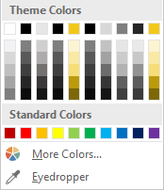
Slide Palette Info
The PowerPoint palette for this template has been built for you and is shown below. Avoid using too many colors in your presentation.
Select the 4th color from the left for subheads and 1st level non-bulleted text color, or wherever “color” text is preferred over the default black/white text
Accent colors 1-6 – (6 Theme Colors to the far right)
Text
Dark 2
Accent 1
Accent 2
Accent 3
Accent 4
Accent 5
Accent 6
Use Accent 1 as the main accent color. Use Accent 2 and Accent 3 when additional colors are needed.
Use Accents 4-6 sparingly – only when more colors are necessary.

Slide 7
Chart Example

Slide 8
Lots of data? Minimalize
Gray is used to de-emphasize data that is less important. Use cool gray 3 or cool gray 7. See slide 7 for color formulas.
All elements have the same interior margins as text blocks.
When a chart or graphic, has more elements than can easily be aligned to the grid, align the outer edges of the group, top, bottom, left and right edges to the grid.
It is preferable to keep the group aligned to the left border.
130M
140M
125M
Other
Other
Other
Other
Other
Other

Slide 9
Chart Example

Slide 10
Notes (hidden)
Some speakers at Microsoft like to use this slide for hidden “notes slides”.
Delete it if you don’t want to use it.
Next: <next slide title>

Slide 11
Spatial Data Analysis in Power BI
Tony McGovern

Slide 12
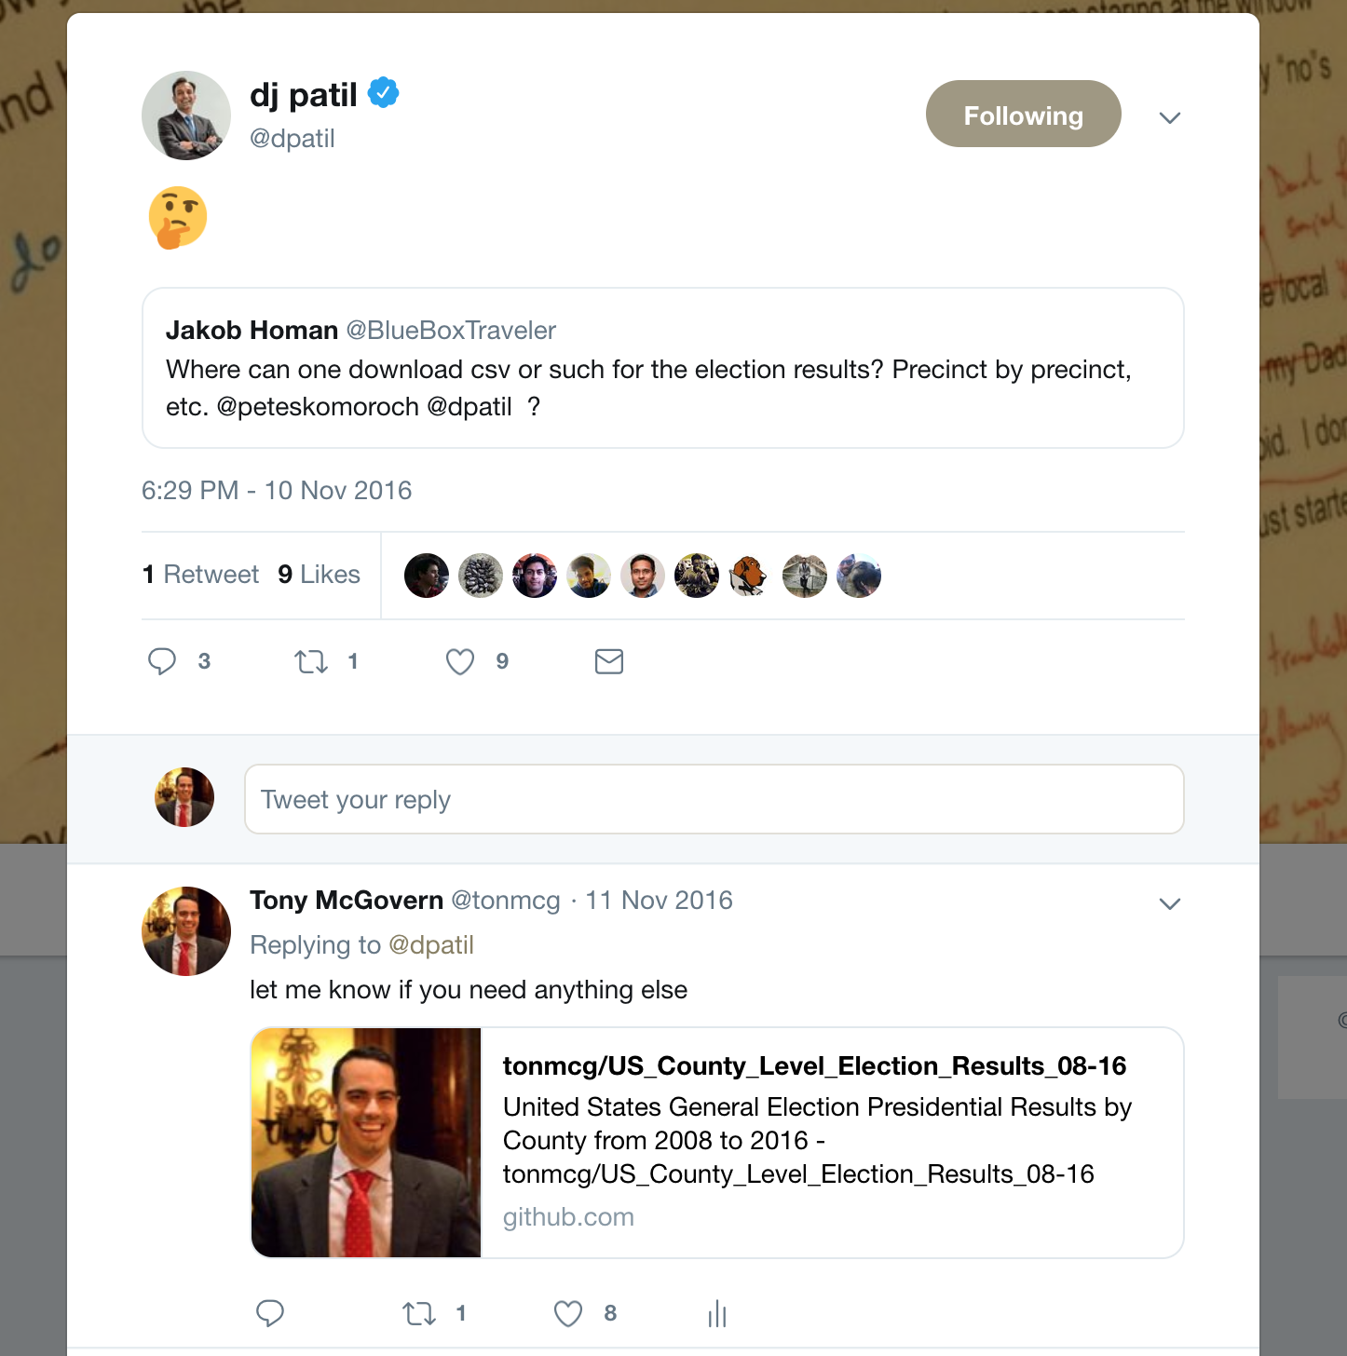
It All Started with a Tweet …
Notes:
On Saturday morning, November 12th 2016, four days after the results of the U.S. presidential election, I read this on Twitter.
Surely this has to be an easy Bing search. Is it true that lower-level U.S. presidential election results are no where to be found? I see them everywhere: NYTimes, Washington Post, CNN, BBC, etc.
After putzing around for 20 or so minutes, I found out that yes, that data is available, but it's not open data. It's not available for me and you.
So, with the blessing of my wife and kids, I set out that day to change that.

Slide 13
Beautiful Thematic Maps (Not in Power BI)
Notes:
WHAT'S THE STORY?
So I set about trying to explain the results of the election through visuals and analysis. And what did I learn? Not only was county-level U.S. 2016 election data nowhere to be found, simple maps that showed these results, or these results with other data were non existent. So I created those as well.
Subscribers to the NYTimes or the Washington Post shouldn't be the only ones who have access to county-level election data or maps.
After 120+ hours scraping websites with Python, creating interactive maps with JavaScript, and performing analysis in R, I realized a few important lessons:
- it's hard to update this data
- it's even harder to update the map
- it's super duper hard to perform advanced analytics and share it with the world.
WHY IS THIS IMPORTANT?
Power BI offers us a better way. With Power BI, you can get and update the data more more easily, update the maps with great third party visuals, and perform advanced analytics that you can share with the world.
TAKEAWAY:
We have the power to make data and advanced analytics more open, more robust, and more widely available

Slide 14
Using R in Spatial Analytics
Notes:
WHAT'S THE STORY?
So I set about trying to explain the results of the election through visuals and analysis. And what did I learn? Not only was county-level U.S. 2016 election data nowhere to be found, simple maps that showed these results, or these results with other data were non existent. So I created those as well.
Subscribers to the NYTimes or the Washington Post shouldn't be the only ones who have access to county-level election data or maps.
After 120+ hours scraping websites with Python, creating interactive maps with JavaScript, and performing analysis in R, I realized a few important lessons:
- it's hard to update this data
- it's even harder to update the map
- it's super duper hard to perform advanced analytics and share it with the world.
WHY IS THIS IMPORTANT?
Power BI offers us a better way. With Power BI, you can get and update the data more more easily, update the maps with great third party visuals, and perform advanced analytics that you can share with the world.
TAKEAWAY:
We have the power to make data and advanced analytics more open, more robust, and more widely available

Slide 15
Session Agenda
Explore out of the box spatial analytics in Power BI
Understand how to build and deploy machine learning models in Azure Machine Learning Studio
See how Power BI consumes Azure ML models for more robust spatial analytics
Notes:
Create beautiful thematic maps in Power BI
Understand what out of the box tools are available to enhance analysis

Slide 16

Tony McGovern
Hacker. Artist. Storyteller. Data lover.
Data Scientist
emdata.ai
http://github.com/tonmcg/
@tonmcg
Notes:
Data Scientist at emdata
We love Power BI helps us easily build impactful data applications that we allow us to scale at a fraction of the time, energy, and cost
And we love working with organizations that are making a difference in the world -- for us Power BI is the way for everyone to do more, better

Slide 17
Out of the Box Analytics in Mapbox Visual

Slide 18
Build and Deploy ML Models in Azure ML Studio

Slide 19
Consume Azure ML Models in Power BI

Slide 20
Use Twitter!
Notes:
Remember that tweet that started this talk? The one where DJ Patil asks where we can find 2016 election data?
Well I responded a day later.
I'm absolutely convinced that if I had started this project with Power BI, I would have responded that same day with not only the data, but a full Power BI application ready to share

Slide 21
Resources
Mapbox Visual https://www.mapbox.com/help/power-bi-choropleth-map/
Mapbox Studio https://www.mapbox.com/studio/
Azure Machine Learning Studio https://studio.azureml.net/
Socrata Open Data API
https://dev.socrata.com/
Build and Deploy Models as Predictive Experiments in Azure ML Studio
https://docs.microsoft.com/en-us/azure/machine-learning/studio/walkthrough-develop-predictive-solution
Notes:
Create beautiful thematic maps in Power BI
Use those maps for impactful spatial analysis
Understand how to mix in machine learning to your Power BI reports

Slide 22
Questions?

Slide 23
Don’t forget to join your local PUG to enjoy year-round networking and learning.

